Slide 1
BERT
Yogesh Kulkarni

Slide 2
Scratch Notes
Transformer as architecture: No recurrence but attention
Attention is softmax output fed back in each iteration
Goal of masking task is to learn language, ie features, actual task need small supervised data for finetuning stored as pre training

Slide 3
Background
Till word2vec

Slide 4
How do we represent the meaning of a word?
Definition: meaning (Webster dictionary)
the idea that is represented by a word, phrase, etc.
the idea that a person wants to express by using words, signs, etc.
the idea that is expressed in a work of writing, art, etc. Commonest linguistic way of thinking of meaning:
signifier (symbol) ⟺ signified (idea or thing)
= denotational semantics
Christopher Manning

Slide 5

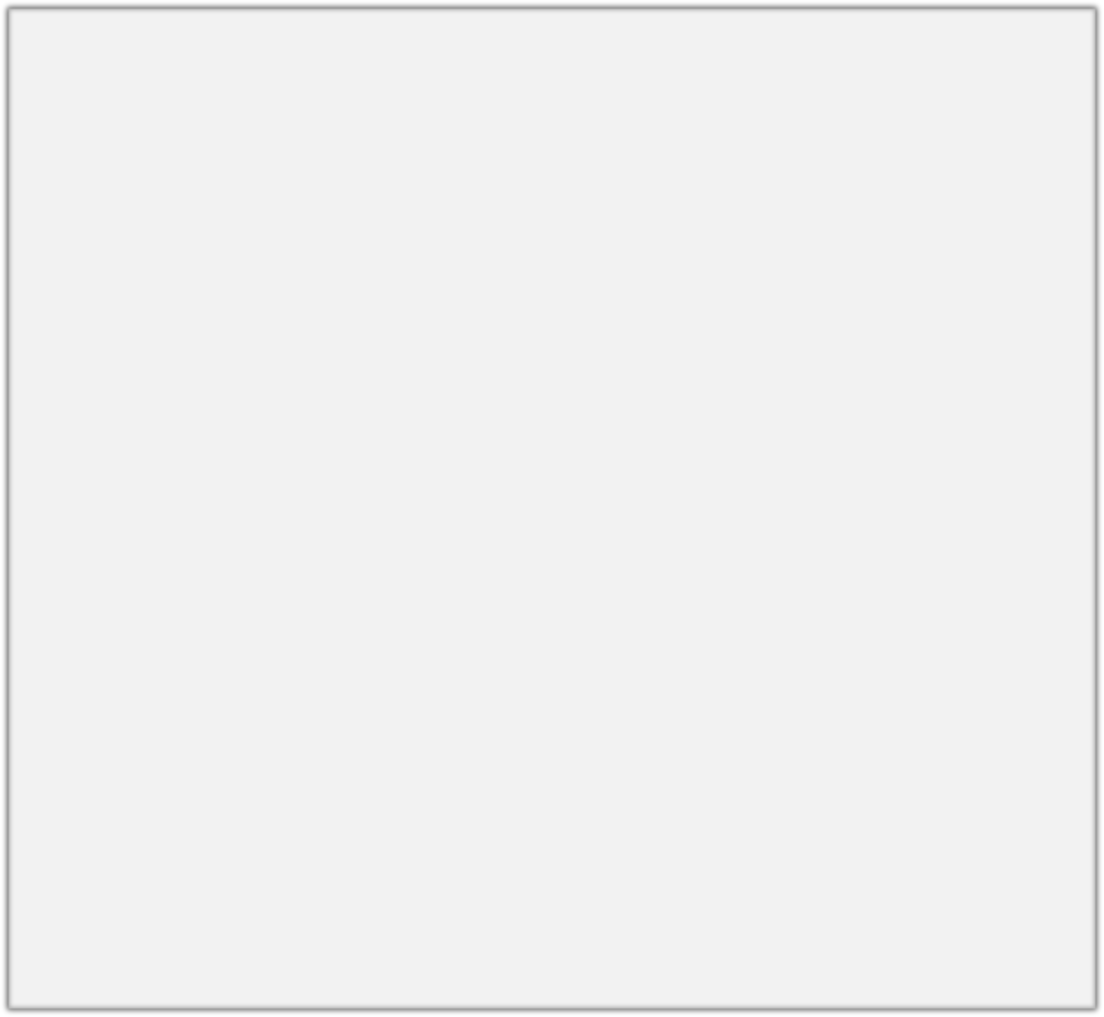
How do we have usable meaning in a computer?
Common solution: Use e.g. WordNet, a thesaurus containing lists of synonym sets and hypernyms (“is a” relationships).
e.g. synonym sets containing “good”: e.g. hypernyms of “panda”:
from nltk.corpus import wordnet as wn
poses = { 'n':'noun', 'v':'verb', 's':'adj (s)', 'a':'adj', 'r':'adv'}
for synset in wn.synsets("good"):
print("{}: {}".format(poses[synset.pos()],
", ".join([l.name() for l in synset.lemmas()])))
from nltk.corpus import wordnet as wn panda = wn.synset("panda.n.01") hyper = lambda s: s.hypernyms() list(panda.closure(hyper))
noun: good
noun: good, goodness noun: good, goodness
noun: commodity, trade_good, good adj: good
adj (sat): full, good adj: good
adj (sat): estimable, good, honorable, respectable adj (sat): beneficial, good
adj (sat): good
adj (sat): good, just, upright
…
adverb: well, good
adverb: thoroughly, soundly, good
[Synset('procyonid.n.01'), Synset('carnivore.n.01'), Synset('placental.n.01'), Synset('mammal.n.01'), Synset('vertebrate.n.01'), Synset('chordate.n.01'), Synset('animal.n.01'), Synset('organism.n.01'), Synset('living_thing.n.01'), Synset('whole.n.02'),
Synset('object.n.01'), Synset('physical_entity.n.01'), Synset('entity.n.01')]
Christopher Manning

Slide 6
Problems with resources like WordNet
Great as a resource but missing nuance
e.g. “proficient” is listed as a synonym for “good”. This is only correct in some contexts.
Missing new meanings of words
e.g., wicked, badass, nifty, wizard, genius, ninja, bombest
Impossible to keep up-to-date!
Subjective
Requires human labor to create and adapt
Can’t compute accurate word similarity
Christopher Manning

Slide 7
Representing words as discrete symbols
In traditional NLP, we regard words as discrete symbols: hotel, conference, motel – a localist representation
Means one 1, the rest 0s
Words can be represented by one-hot vectors:
motel = [0 0 0 0 0 0 0 0 0 0 1 0 0 0 0]
hotel = [0 0 0 0 0 0 0 1 0 0 0 0 0 0 0]
Vector dimension = number of words in vocab (e.g. 500,000)
Christopher Manning

Slide 8
Problem with words as discrete symbols
Sec. 9.2.2
Example: in web search, if user searches for “Seattle motel”, we would like to match documents containing “Seattle hotel”.
But:
motel = [0 0 0 0 0 0 0 0 0 0 1 0 0 0 0]
hotel = [0 0 0 0 0 0 0 1 0 0 0 0 0 0 0]
These two vectors are orthogonal.
There is no natural notion of similarity for one-hot vectors!
Solution:
Could try to rely on WordNet’s list of synonyms to get similarity?
But it is well-known to fail badly: incompleteness, etc.
Instead: learn to encode similarity in the vectors themselves
Christopher Manning

Slide 9
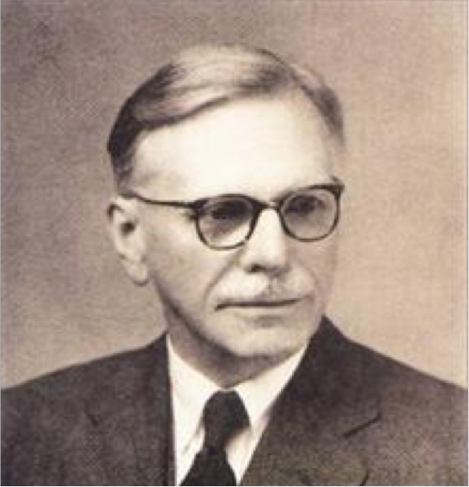
Representing words by their context
Distributional semantics: A word’s meaning is given by the words that frequently appear close-by
“You shall know a word by the company it keeps” (J. R. Firth 1957)
One of the most successful ideas of modern statistical NLP!
When a word w appears in a text, its context is the set of words that appear nearby (within a fixed-size window).
Use the many contexts of w to build up a representation of w
…government debt problems turning into
…saying that Europe needs unified
…India has just given its
banking
banking banking
crises as happened in 2009…
regulation to replace the hodgepodge… system a shot in the arm…
These context words will represent banking
Christopher Manning

Slide 10
What can we learn from reconstructing input?
Stanford University is located in , California.
John Hewitt

Slide 11
What can we learn from reconstructing the input?
I put fork down on the table.
John Hewitt

Slide 12
What can we learn from reconstructing the input?
The woman walked across the street, checking for traffic over shoulder.
John Hewitt

Slide 13
What can we learn from reconstructing the input?
I went to the ocean to see the fish, turtles, seals, and .
John Hewitt

Slide 14
What can we learn from reconstructing input?
Overall, the value I got from the two hours watching it was the sum total of the popcorn and the drink.
The movie was .
John Hewitt

Slide 15
What can we learn from reconstructing input?
Iroh went into the kitchen to make some tea.
Standing next to Iroh, Zuko pondered his destiny.
Zuko left the .
John Hewitt

Slide 16
What can we learn from reconstructing input?
I was thinking about the sequence that goes 1, 1, 2, 3, 5, 8, 13, 21,
John Hewitt

Slide 17
Word vectors
We will build a dense vector for each word, chosen so that it is similar to vectors of words that appear in similar contexts
0.286
0.792
−0.177
−0.107
0.109
−0.542
0.349
0.271
banking =
Note: word vectors are sometimes called word embeddings or word representations. They are a distributed representation.
Christopher Manning

Slide 18
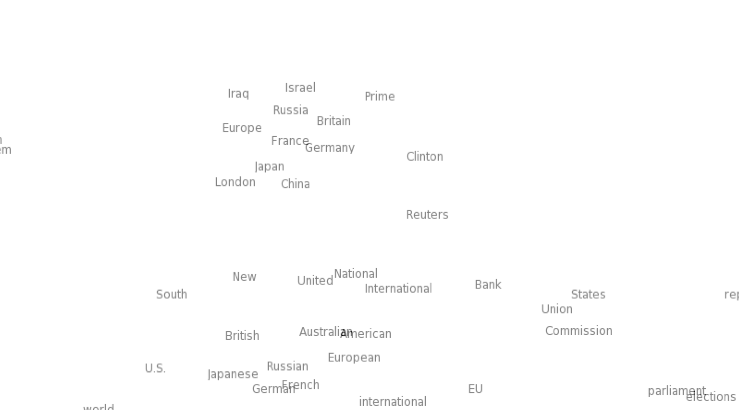

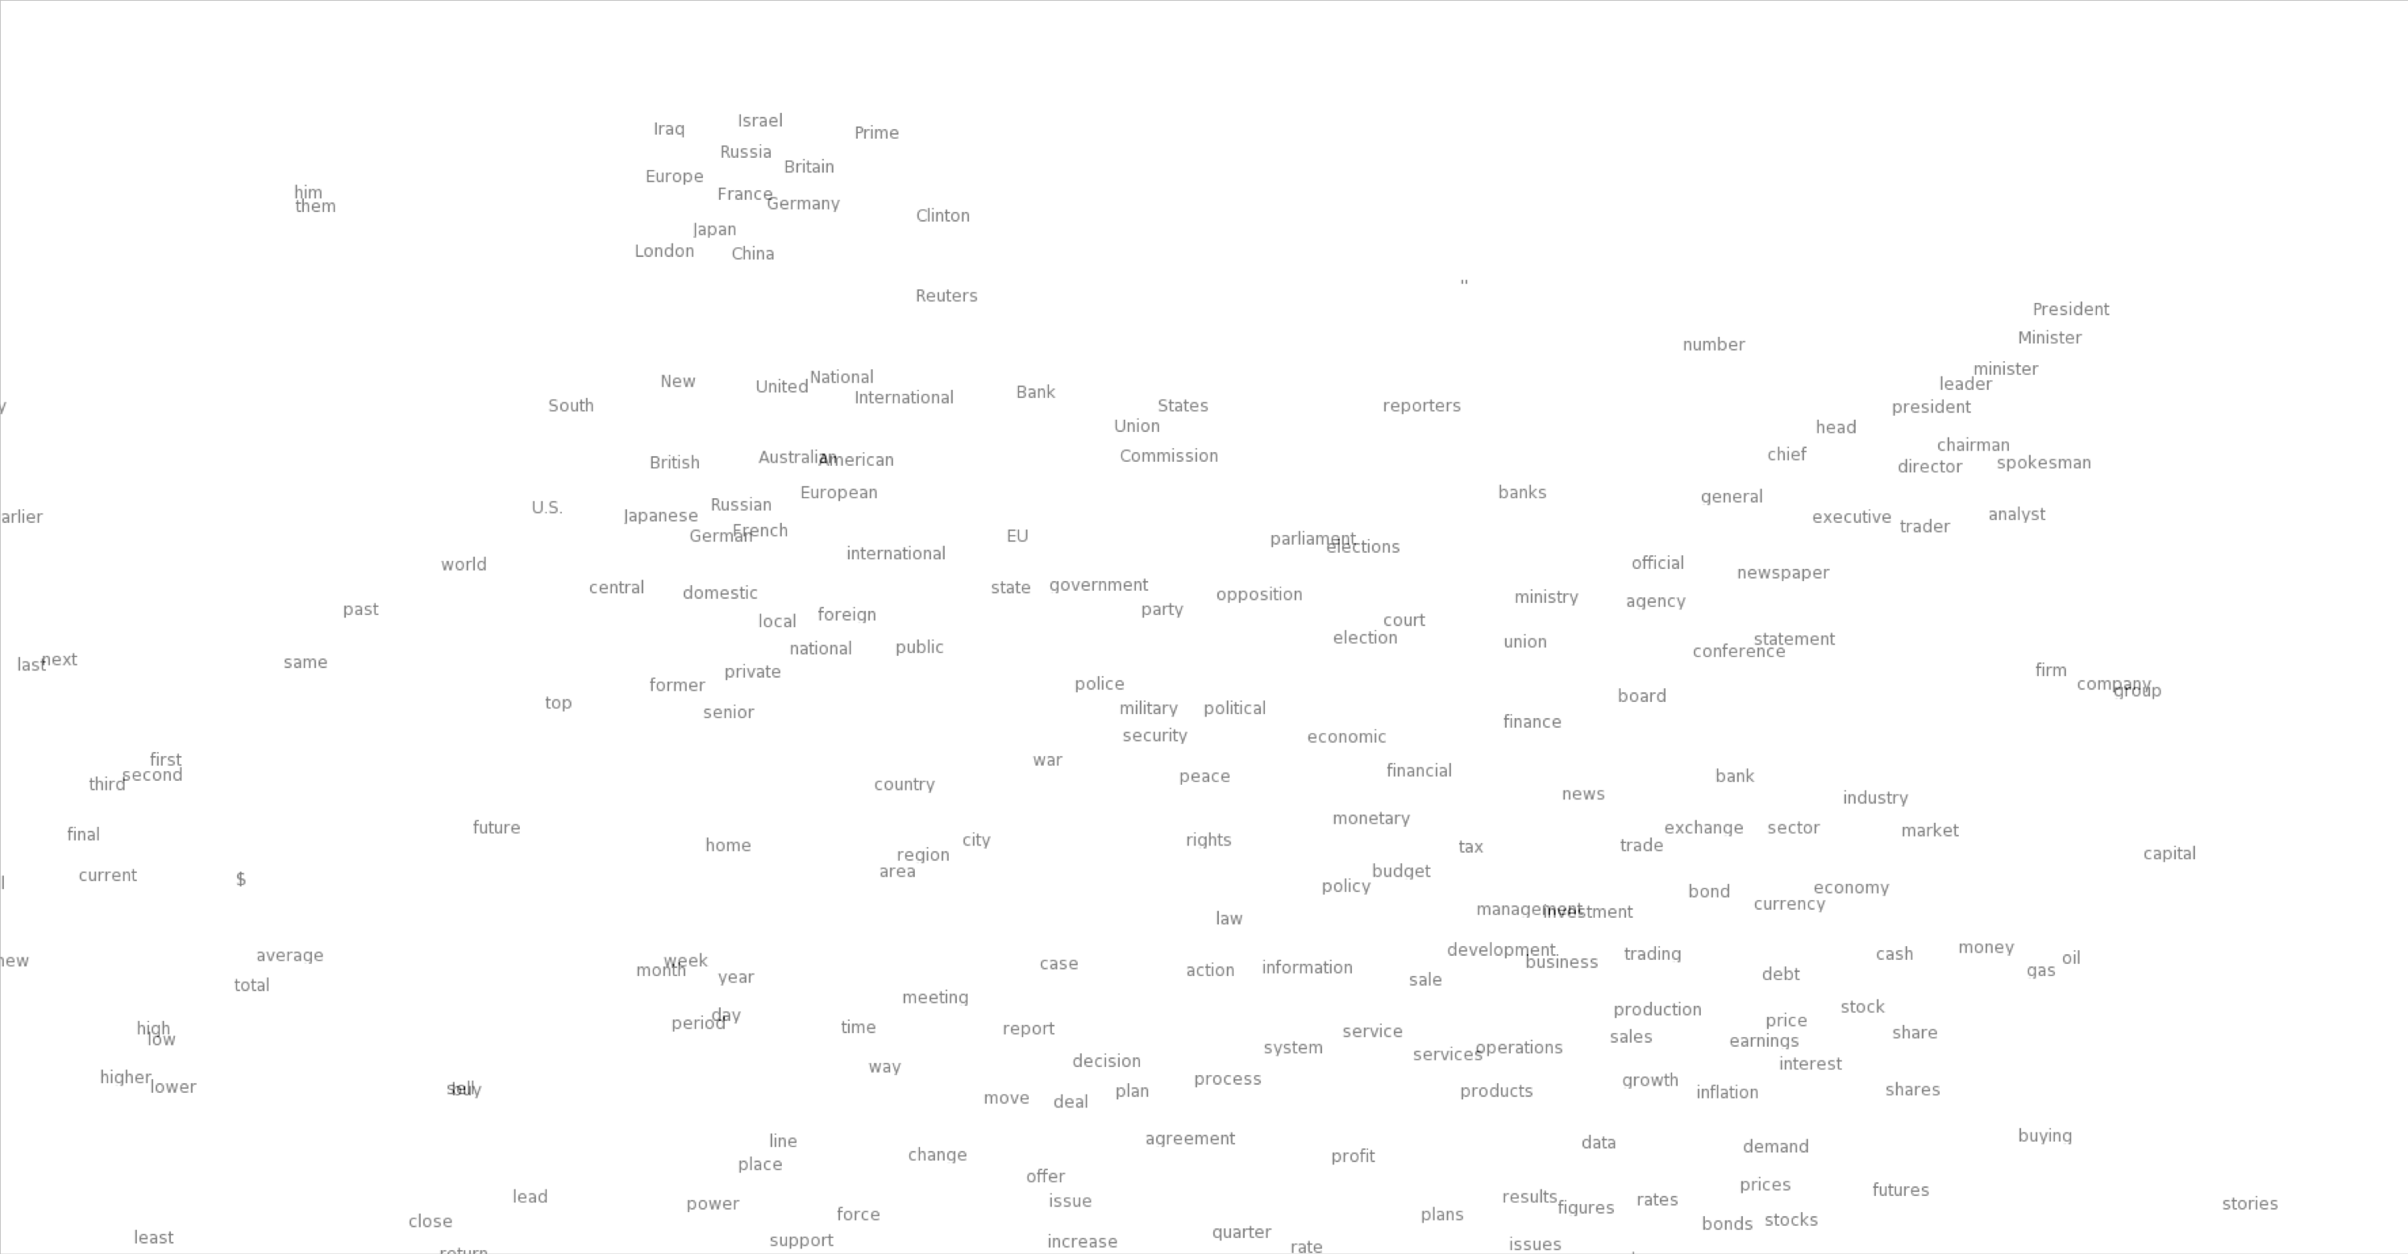
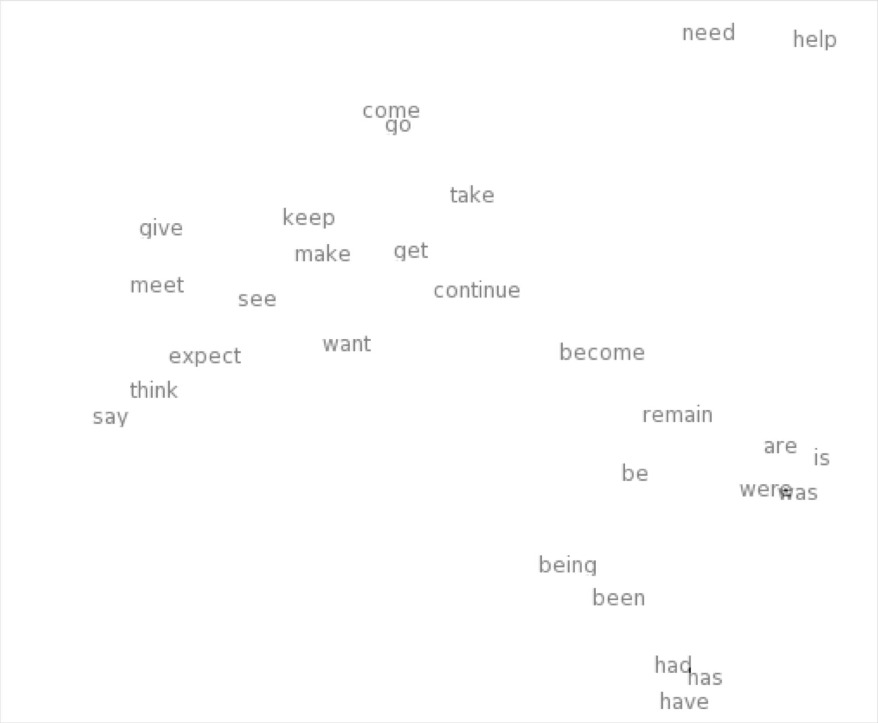
Word meaning as a neural word vector: visualization
0.286
0.792
−0.177
−0.107
0.109
−0.542
0.349
0.271
0.487
expect =
Christopher Manning

Slide 19
Word2Vec Overview
Word2vec (Mikolov et al. 2013) is a framework for learning word vectors
Idea:
We have a large corpus of text
Every word in a fixed vocabulary is represented by a vector
Go through each position t in the text, which has a center word
c and context (“outside”) words o
Use the similarity of the word vectors for c and o to calculate the probability of o given c (or vice versa)
Keep adjusting the word vectors to maximize this probability
Christopher Manning

Slide 20
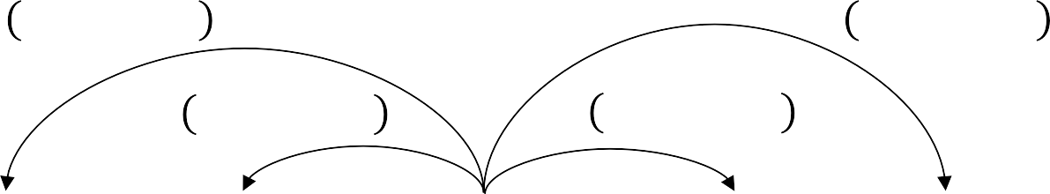
Word2Vec Overview
Example windows and process for computing P(w_{t+j}|w_{t})
P w_{t-2}|w_{t}
P w_{t+2}|w_{t}
P w_{t-1}|w_{t}
P w_{t+1}|w_{t}
…
problems
turning
into
banking
crises
as
…
outside context words in window of size 2
center word at position t
outside context words in window of size 2
Christopher Manning

Slide 21
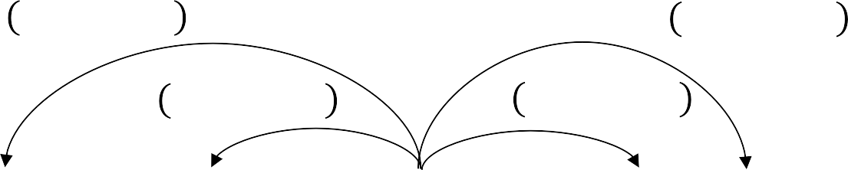
Word2Vec Overview
Example windows and process for computing P(w_{t+j}|w_{t})
P w_{t-2}|w_{t}
P w_{t+2}|w_{t}
P w_{t-1}|w_{t}
P w_{t+1}|w_{t}
…
problems
turning
into
banking
crises
as
…
outside context words in window of size 2
center word at position t
outside context words in window of size 2
Christopher Manning

Slide 22
Word2Vec: objective function
For each position t = 1, … , T, predict context words within a window of fixed size m, given center word w_{j}.
The objective function is the (average) negative log likelihood:
Minimizing objective function ⟺ Maximizing predictive accuracy
Christopher Manning

Slide 23
Word2Vec: objective function
We want to minimize the objective function:
Question: How to calculate P(w_{t+j}|w_{t} ; θ)?
Answer: We will use two vectors per word w:
v_{w} when w is a center word
u_{w} when w is a context word
Then for a center word c and a context word o:
Christopher Manning

Slide 24
Word2Vec: prediction function
This is an example of the softmax function ℝ^{n} → ℝ^{n}
The softmax function maps arbitrary values to a probability distribution p_{i}
“max” because amplifies probability of largest x_{i}
“soft” because still assigns some probability to smaller x_{i}
Frequently used in Deep Learning
Christopher Manning

Slide 25
Sequence Recurrence Models
RNNs and LSTMs

Slide 26
Sequence-to-Sequence (seq2seq)
See any issues with this traditional seq2seq paradigm?

Slide 27
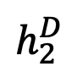

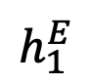
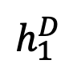


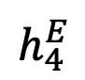
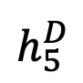
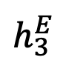

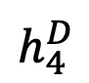
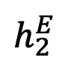
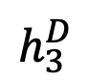

Sequence-to-Sequence (seq2seq)
It’s crazy that the entire “meaning” of the 1st sequence is expected to be packed into this one embedding, and that the encoder then never interacts w/ the decoder again. Hands free.
$${\hat{y}}_{1}$$
$${\hat{y}}_{2}$$
$${\hat{y}}_{3}$$
$${\hat{y}}_{4}$$
$${\hat{y}}_{5}$$
$$h_{1}^{E}$$
$$h_{2}^{E}$$
$$h_{3}^{E}$$
$$h_{4}^{E}$$
$$h_{1}^{D}$$
$$h_{2}^{D}$$
$$h_{3}^{D}$$
$$h_{4}^{D}$$
$$h_{5}^{D}$$
Hidden layer
Input layer
The
brown
dog
ran
Le
chien
brun
a
couru
ENCODER RNN
DECODER RNN

Slide 28
Sequence-to-Sequence (seq2seq)
Instead, what if the decoder, at each step, pays attention to a distribution of all of the encoder’s hidden states?

Slide 29
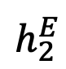
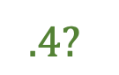
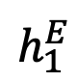
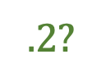
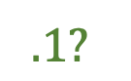
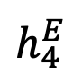
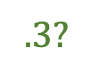
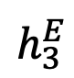
seq2seq + Attention
Q: How do we determine how much to pay attention to each of the encoder’s hidden layers?
$$.4?$$
$$.3?$$
$$.1?$$
$$.2?$$
$$h_{1}^{E}$$
$$h_{2}^{E}$$
$$h_{3}^{E}$$
$$h_{4}^{E}$$
Hidden layer
Input layer
The
brown
dog
ran
ENCODER RNN

Slide 30
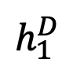
seq2seq + Attention
Q: How do we determine how much to pay attention to each of the encoder’s hidden layers?
A: Let’s base it on our decoder’s previous hidden state (our latest representation of meaning) and all of the encoder’s hidden layers!
$$h_{1}^{E}$$
$$h_{2}^{E}$$
$$h_{3}^{E}$$
$$h_{4}^{E}$$
$$h_{1}^{D}$$
Hidden layer
<s>
Input layer
The
brown
dog
ran
ENCODER RNN

Slide 31
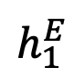
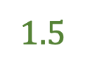
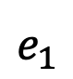
seq2seq + Attention
Q: How do we determine how much to pay attention to each of the encoder’s hidden layers?
A: Let’s base it on our decoder’s previous hidden state (our latest representation of meaning) and all of the encoder’s hidden layers! We want to measure similarity between decoder hidden state and encoder hidden stateS in some ways.
Could be cosine similarity
$$h_{1}^{E}$$
$$h_{2}^{E}$$
$$h_{3}^{E}$$
$$h_{4}^{E}$$
$$h_{1}^{D}$$
$$e_{1}$$
$$1.5$$
Hidden layer
<s>
$$h_{1}^{E}$$
$$h_{1}^{D}$$
Separate FFNN
Input layer
The
brown
dog
ran
ENCODER RNN
DECODER RNN
ATTENTION LAYER

Slide 32
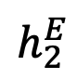
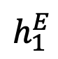
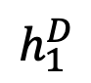
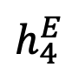
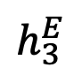
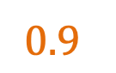
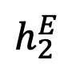
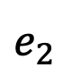
seq2seq + Attention
Q: How do we determine how much to pay attention to each of the encoder’s hidden layers?
A: Let’s base it on our decoder’s previous hidden state (our latest representation of meaning) and all of the encoder’s hidden layers! We want to measure similarity between decoder hidden state and encoder hidden stateS in some ways.
Could be cosine similarity
$$h_{1}^{E}$$
$$h_{2}^{E}$$
$$h_{3}^{E}$$
$$h_{4}^{E}$$
$$h_{1}^{D}$$
$$e_{2}$$
$$0.9$$
Hidden layer
<s>
$$h_{2}^{E}$$
$$h_{1}^{D}$$
Separate FFNN
Input layer
The
brown
dog
ran
ENCODER RNN
DECODER RNN
ATTENTION LAYER

Slide 33
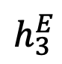
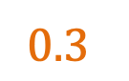
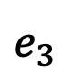
seq2seq + Attention
Q: How do we determine how much to pay attention to each of the encoder’s hidden layers?
A: Let’s base it on our decoder’s previous hidden state (our latest representation of meaning) and all of the encoder’s hidden layers! We want to measure similarity between decoder hidden state and encoder hidden stateS in some ways.
Could be cosine similarity
$$h_{1}^{E}$$
$$h_{2}^{E}$$
$$h_{3}^{E}$$
$$h_{4}^{E}$$
$$h_{1}^{D}$$
$$e_{3}$$
$$0.3$$
Hidden layer
<s>
$$h_{3}^{E}$$
$$h_{1}^{D}$$
Separate FFNN
Input layer
The
brown
dog
ran
ENCODER RNN
DECODER RNN
ATTENTION LAYER

Slide 34
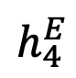
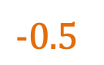
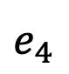
seq2seq + Attention
Q: How do we determine how much to pay attention to each of the encoder’s hidden layers?
A: Let’s base it on our decoder’s previous hidden state (our latest representation of meaning) and all of the encoder’s hidden layers! We want to measure similarity between decoder hidden state and encoder hidden stateS in some ways.
Could be cosine similarity
$$h_{1}^{E}$$
$$h_{2}^{E}$$
$$h_{3}^{E}$$
$$h_{4}^{E}$$
$$h_{1}^{D}$$
$$e_{4}$$
$$−0.5$$
Hidden layer
<s>
$$h_{4}^{E}$$
$$h_{1}^{D}$$
Separate FFNN
Input layer
The
brown
dog
ran
ENCODER RNN
DECODER RNN
ATTENTION LAYER

Slide 35
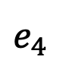
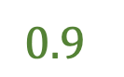
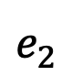
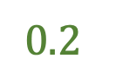
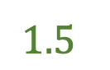
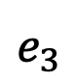
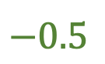
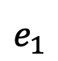
seq2seq + Attention
Q: How do we determine how much to pay attention to each of the encoder’s hidden layers?
A: Let’s base it on our decoder’s previous hidden state (our latest representation of meaning) and all of the encoder’s hidden layers!
Attention (raw scores)
$$h_{1}^{E}$$
$$h_{2}^{E}$$
$$h_{3}^{E}$$
$$h_{4}^{E}$$
$$h_{1}^{D}$$
$$e_{1}$$
$$1.5$$
$$e_{2}$$
$$0.9$$
$$e_{3}$$
$$0.2$$
Hidden layer
$$e_{4}$$
$$−0.5$$
<s>
Input layer
The
brown
dog
ran
ENCODER RNN
DECODER RNN
ATTENTION LAYER

Slide 36

seq2seq + Attention
Q: How do we determine how much to pay attention to each of the encoder’s hidden layers?
A: Let’s base it on our decoder’s previous hidden state (our latest representation of meaning) and all of the encoder’s hidden layers!
Attention (raw scores)
$$h_{1}^{E}$$
$$h_{2}^{E}$$
$$h_{3}^{E}$$
$$h_{4}^{E}$$
$$h_{1}^{D}$$
$$e_{1}$$
$$1.5$$
$$e_{2}$$
$$0.9$$
$$e_{3}$$
$$0.2$$
Hidden layer
$$e_{4}$$
$$−0.5$$
Attention (softmax’d)
<s>
$$a_{i}^{1}=\frac{exp⁡(e_{i})}{\sum_{i}^{N}{{exp⁡(e}_{1})}}$$
Input layer
The
brown
dog
ran
ENCODER RNN
DECODER RNN
ATTENTION LAYER

Slide 37




seq2seq + Attention
Q: How do we determine how much to pay attention to each of the encoder’s hidden layers?
A: Let’s base it on our decoder’s previous hidden state (our latest representation of meaning) and all of the encoder’s hidden layers!
Attention (raw scores)
$$h_{1}^{E}$$
$$h_{2}^{E}$$
$$h_{3}^{E}$$
$$h_{4}^{E}$$
$$h_{1}^{D}$$
$$e_{1}$$
$$1.5$$
$$e_{2}$$
$$0.9$$
$$e_{3}$$
$$0.2$$
Hidden layer
$$e_{4}$$
$$−0.5$$
Attention (softmax’d)
<s>
$$a_{1}^{1}=0.51$$
Input layer
The
brown
dog
ran
$$a_{2}^{1}=0.28$$
$$a_{3}^{1}=0.14$$
ENCODER RNN
$$a_{3}^{1}=0.07$$

Slide 38








seq2seq + Attention
$$c_{1}^{D}$$
We multiply each hidden layer by its $a_{i}^{1}$attention weights and then add the resulting vectors to create a context vector $c_{1}^{D}$
$$a_{1}^{1}$$
$$a_{2}^{1}$$
$$a_{3}^{1}$$
$$a_{4}^{1}$$
$$h_{1}^{E}$$
$$h_{2}^{E}$$
$$h_{3}^{E}$$
$$h_{4}^{E}$$
$$h_{1}^{D}$$
Hidden layer
Attention (softmax’d)
<s>
$$a_{1}^{1}=0.51$$
Input layer
The
brown
dog
ran
$$a_{2}^{1}=0.28$$
$$a_{3}^{1}=0.14$$
ENCODER RNN
$$a_{4}^{1}=0.07$$

Slide 39







seq2seq + Attention
NOTE: each attention weight $a_{i}^{j}$ is based on the decoder’s current hidden state, too.
$$c_{1}^{D}$$
El
$${\hat{y}}_{1}$$
$$a_{1}^{1}$$
$$a_{2}^{1}$$
$$a_{3}^{1}$$
$$a_{4}^{1}$$
Hidden layer
$[c_{1}^{D}$,<S>$]$
Input layer
The
brown
dog
ran
DECODER RNN
ENCODER RNN

Slide 40


seq2seq + Attention
NOTE: each attention weight $a_{i}^{j}$ is based on the decoder’s current hidden state, too.
$$c_{1}^{D}$$
El
perro
$${\hat{y}}_{1}$$
$${\hat{y}}_{2}$$
$$a_{1}^{1}$$
$$a_{2}^{1}$$
$$a_{3}^{1}$$
$$a_{4}^{1}$$
Hidden layer
$[c_{1}^{D}$,<S>$]$
$[c_{2}^{D}$,${\hat{y}}_{1}]$
Input layer
The
brown
dog
ran
DECODER RNN
ENCODER RNN

Slide 41






seq2seq + Attention
NOTE: each attention weight $a_{i}^{j}$ is based on the decoder’s current hidden state, too.
$$c_{1}^{D}$$
El
perro
marrón
$${\hat{y}}_{1}$$
$${\hat{y}}_{2}$$
$${\hat{y}}_{3}$$
$$a_{1}^{1}$$
$$a_{2}^{1}$$
$$a_{3}^{1}$$
$$a_{4}^{1}$$
Hidden layer
$[c_{1}^{D}$,<S>$]$
$[c_{2}^{D}$,${\hat{y}}_{1}]$
$[c_{3}^{D}$,${\hat{y}}_{2}]$
Input layer
The
brown
dog
ran
DECODER RNN
ENCODER RNN

Slide 42


seq2seq + Attention
NOTE: each attention weight $a_{i}^{j}$ is based on the decoder’s current hidden state, too.
$$c_{1}^{D}$$
El
perro
marrón
corrio
$${\hat{y}}_{1}$$
$${\hat{y}}_{2}$$
$${\hat{y}}_{3}$$
$${\hat{y}}_{4}$$
$$a_{1}^{1}$$
$$a_{2}^{1}$$
$$a_{3}^{1}$$
$$a_{4}^{1}$$
Hidden layer
$[c_{1}^{D}$,<S>$]$
$[c_{2}^{D}$,${\hat{y}}_{1}]$
$[c_{3}^{D}$,${\hat{y}}_{2}]$
$[c_{4}^{D}$,${\hat{y}}_{3}]$
Input layer
The
brown
dog
ran
DECODER RNN
ENCODER RNN

Slide 43

seq2seq + Attention
Attention:
greatly improves seq2seq results
allows us to visualize the contribution each word gave during each step of the decoder
Image source: Fig 3 in Bahdanau et al., 2015

Slide 44

ELMo: Embeddings from Language Models
Deep contextualized word representations. Peters et al. NAACL 2018. https://arxiv.org/abs/1802.05365
“Instead of using a fixed embedding for each word, ELMo looks at the entire sentence before assigning each word in it an embedding.”
Breakout version of word token vectors or
contextual word vectors
Learn word token vectors using long contexts not context windows (here, whole sentence, could be longer)
Learn a deep Bi-NLM and use all its layers in prediction
Christopher Manning

Slide 45
ELMo: Embeddings from Language Models
Train a bidirectional LM
Aim at performant but not overly large LM:
Use 2 biLSTM layers
Use character CNN to build initial word representation
User 4096 dim hidden/cell LSTM states with 512 dim projections to next input
Use a residual connection
Tie parameters of token input and output (softmax) and tie these between forward and backward LMs
Adapted from Christopher Manning

Slide 46


ELMo used in a sequence tagger
Christopher Manning, figure from https://tsenghungchen.github.io/posts/elmo/, paper at https://arxiv.org/pdf/1802.05365.pdf

Slide 47

ELMo results: Great for all tasks
Christopher Manning

Slide 48
ELMo: Roles of different layers
The two biLSTM NLM layers have differentiated uses/meanings
Lower layer is better for lower-level syntax, etc.
Part-of-speech tagging, syntactic dependencies, NER
Higher layer is better for higher-level semantics
Sentiment, Semantic role labeling, question answering, SNLI
Adapted from Christopher Manning

Slide 49
Issues with recurrent models: Linear interaction distance
O(sequence length) steps for distant word pairs to interact means:
Hard to learn long-distance dependencies (because gradient problems!)
Linear order of words is “baked in”; not necessarily the right way to think about sentences…
The chef who …
was
Info of chef has gone through O(sequence length) many layers!
Adapted from John Hewitt

Slide 50
Issues with recurrent models: Lack of parallelizability
Forward and backward passes have O(sequence length) unparallelizable operations
GPUs can perform a bunch of independent computations at once!
But future RNN hidden states can’t be computed in full before past RNN
hidden states have been computed
Inhibits training on very large datasets!
1
2
3
T
0
1
2
T-1
h₁ h₂
h_{T}
Numbers indicate min # of steps before a state can be computed
John Hewitt

Slide 51
If not recurrence, then what? How about word windows?
Word window models aggregate local contexts
Also known as 1D convolution
Number of unparallelizable operations not tied to sequence length!
window window embedding
2 |  | 2 |  | 2 |  | 2 |  | 2 |  | 2 |  | 2 |  | 2
1 |  | 1 |  | 1 |  | 1 |  | 1 |  | 1 |  | 1 |  | 1
0 |  | 0 |  | 0 |  | 0 |  | 0 |  | 0 |  | 0 |  | 0
h₁
h₂
h_{T}
Numbers indicate min # of steps before a state can be computed
Adapted from John Hewitt

Slide 52
If not recurrence, then what? How about word windows?
Word window models aggregate local contexts
What about long-distance dependencies?
Stacking word window layers allows interaction between farther words
But if your sequences are too long, you’ll just ignore long-distance context
window (size=5)
Red states
indicate those
“visible” to h_{k}
window (size=5) embedding
h₁
h_{k}
h_{T}
Too far from h_{k} to be considered
Adapted from John Hewitt

Slide 53
If not recurrence, then what? How about attention?
Attention treats each word’s representation as a query to access and incorporate information from a set of values.
We saw attention from the decoder to the encoder; today we’ll think about
attention within a single sentence.
If attention gives us access to any state… maybe we can just use attention and don’t need the RNN?
Number of unparallelizable operations not tied to sequence length.
All words interact at every layer!
2 |  | 2 |  | 2 |  | 2 |  | 2 |  | 2 |  | 2 |  | 2
1 |  | 1 |  | 1 |  | 1 |  | 1 |  | 1 |  | 1 |  | 1
0 |  | 0 |  | 0 |  | 0 |  | 0 |  | 0 |  | 0 |  | 0
All words attend
to all words in previous layer; most arrows here are omitted
attention
attention embedding
h₁
h₂
h_{T}
Adapted from John Hewitt

Slide 54
Self-Attention
Attention operates on queries, keys, and values.
We have some queries 𝑞 , 𝑞 , … , 𝑞 . Each query is 𝑞_{i} ∈ ℝ^{𝑑}
The number of queries can differ from the number of keys and
values in practice.
1 2 𝑇
We have some keys 𝑘₁, 𝑘₂, … , 𝑘_{𝑇}. Each key is 𝑘_{𝑖} ∈ ℝ^{𝑑}
We have some values 𝑣₁, 𝑣₂, … , 𝑣_{𝑇}. Each value is 𝑣_{𝑖} ∈ ℝ^{𝑑}
In self-attention, the queries, keys, and values are drawn from the same source.
For example, if the output of the previous layer is 𝑥₁, … , 𝑥_{𝑇}, (one vec per word) we could let 𝑣_{𝑖} = 𝑘_{𝑖} = 𝑞_{𝑖} = 𝑥_{𝑖} (that is, use the same vectors for all of them!)
The (dot product) self-attention operation is as follows:
exp(𝑒_{𝑖𝑗})
𝑒 = 𝑞_{i}^{𝖳}𝑘 𝛼 =
output = Σ _{𝑗} 𝛼 𝑣
𝑖𝑗 𝑗
𝑖𝑗
𝑖 𝑖𝑗 𝑗
𝑖
Σ
_{𝑗'}
exp(𝑒_{𝑖𝑗’} )
Compute outputs as weighted sum of values
Compute key- query affinities
Compute attention weights from affinities
(softmax)
John Hewitt

Slide 55
Self-Attention
In the diagram at the right, we have stacked self-attention blocks, like we might stack LSTM layers.
Can self-attention be a drop-in
replacement for recurrence?
No. It has a few issues, which
we’ll go through.
First, self-attention is an operation on sets. It has no inherent notion of order.
self-attention
𝑞₁
𝑘₁ 𝑣₁
𝑘₂
𝑞₂
𝑞₃
𝑞_{𝑇}
𝑣₂ 𝑘₃ 𝑣₃
𝑘_{𝑇}
𝑣_{𝑇}
…
self-attention
𝑘₂ 𝑣₂ 𝑘₃ 𝑞₃ 𝑣₃
𝑞₁
𝑘₁ 𝑣₁
𝑞₂
𝑘_{𝑇}
𝑞_{𝑇}
𝑣_{𝑇}
…
𝑤₁
The
𝑤₂
chef
𝑤₃
who
𝑤_{𝑇}
food
Self-attention doesn’t know the order of its inputs.
John Hewitt

Slide 56
Barriers and solutions for Self-Attention as a building block
Barriers
Doesn’t have an inherent
notion of order!
Solutions
John Hewitt

Slide 57
Fixing the first self-attention problem: Sequence order
Since self-attention doesn’t build in order information, we need to encode the order of the
sentence in our keys, queries, and values.
Consider representing each sequence index as a vector
𝑝_{𝑖} ∈ ℝ^{𝑑}, for 𝑖 ∈ {1,2, … , 𝑇} are position vectors
Don’t worry about what the 𝑝_{𝑖} are made of yet!
Easy to incorporate this info into our self-attention block: just add the 𝑝_{𝑖} to our inputs!
Let 𝑣_{𝑖} ‘, 𝑘_{𝑖} ‘, 𝑞_{𝑖} ‘ be our old values, keys, and queries.
𝑣_{𝑖} = 𝑣_{𝑖} ‘ + 𝑝_{𝑖}
𝑞_{𝑖} = 𝑞_{𝑖} ‘ + 𝑝_{𝑖}
𝑘_{𝑖} = 𝑘_{𝑖} ‘ + 𝑝_{𝑖}
In deep self-attention networks, we do this at the first layer! You could concatenate them as well, but people mostly just add…
John Hewitt

Slide 58

Position representation vectors through sinusoids
Sinusoidal position representations: concatenate sinusoidal functions of varying periods:
sin(𝑖/10000^{2∗1/𝑑}) cos(𝑖/10000^{2∗1/𝑑})
𝑝_{𝑖} =
𝑑
Dimension
sin(𝑖/10000^{2∗}2^{/𝑑})
𝑑
cos(𝑖/10000^{2∗}2^{/𝑑})
Index in the sequence
Pros:
Periodicity indicates that maybe “absolute position” isn’t as important
Maybe can extrapolate to longer sequences as periods restart!
Cons:
Not learnable; also the extrapolation doesn’t really work!
Image: https://timodenk.com/blog/linear-relationships-in-the-transformers-positional-encoding/
John Hewitt

Slide 59
Barriers and solutions for Self-Attention as a building block
Barriers
Doesn’t have an inherent
notion of order!
Solutions
Add position representations to the inputs
No nonlinearities for deep
learning! It’s all just weighted
averages
John Hewitt

Slide 60
Adding nonlinearities in self-attention
Note that there are no elementwise nonlinearities in self-attention; stacking more self-attention layers just re-averages value vectors
Easy fix: add a feed-forward network
to post-process each output vector.
FF
FF
FF
self-attention
FF
…
FF
FF
FF
self-attention
FF
𝑚_{𝑖} = 𝑀𝐿𝑃 output_{𝑖}
= 𝑊₂ ∗ ReLU 𝑊₁ × output_{𝑖} + 𝑏₁
…
+ 𝑏₂
𝑤₁
The
𝑤₂
chef
𝑤₃
who
𝑤_{𝑇}
food
Intuition: the FF network processes the result of attention
John Hewitt

Slide 61
Barriers and solutions for Self-Attention as a building block
Barriers
Doesn’t have an inherent
notion of order!
No nonlinearities for deep learning magic! It’s all just weighted averages
Need to ensure we don’t “look at the future” when predicting a sequence
Like in machine translation
Or language modeling
Solutions
Add position representations to the inputs
Easy fix: apply the same feedforward network to each self- attention output.
John Hewitt

Slide 62
Masking the future in self-attention
We can look at these (not greyed out) words
To use self-attention in decoders, we need to ensure we can’t peek at the future.
−∞ | −∞ | −∞ | −∞
 | −∞ | −∞ | −∞
 |  | −∞ | −∞
 |  |  | −∞
[START]
At every timestep, we could change the set of keys and queries to include only past words. (Inefficient!)
To enable parallelization, we mask out attention to future words by setting attention scores to −∞.
𝑒_{𝑖𝑗} =
The
For encoding these words
chef
who
𝑞^{𝖳}𝑘_{𝑗}, 𝑗 < 𝑖
𝑖
−∞, 𝑗 ≥ 𝑖
John Hewitt

Slide 63
Barriers and solutions for Self-Attention as a building block
Barriers
Doesn’t have an inherent
notion of order!
No nonlinearities for deep learning magic! It’s all just weighted averages
Need to ensure we don’t “look at the future” when predicting a sequence
Like in machine translation
Or language modeling
Solutions
Add position representations to the inputs
Easy fix: apply the same feedforward network to each self- attention output.
Mask out the future by artificially setting attention weights to 0!
John Hewitt

Slide 64
Necessities for a self-attention building block:
Self-attention:
the basis of the method.
Position representations:
Specify the sequence order, since self-attention is an unordered function of its inputs.
Nonlinearities:
At the output of the self-attention block
Frequently implemented as a simple feed-forward network.
Masking:
In order to parallelize operations while not looking at the future.
Keeps information about the future from “leaking” to the past.
That’s it! But this is not the Transformer model we’ve been hearing about.
John Hewitt

Slide 65
Transformer
Attention is all you need

Slide 66

Popularity
(Ref: Niels Rogge on Huggingface contributions)

Slide 67
Transformers
The Transformer is a model that uses attention to boost the speed with which seq2seq with attention models can be trained. The biggest benefit, however, comes from how The Transformer lends itself to parallelization. We will break it apart and look at how it functions.
In its heart it contains an encoding component, a decoding component, and connections between them.

Slide 68
The encoding is a stack of encoders.
The original paper stacks six of them on top of each other – there’s nothing magical about the number six, one can definitely experiment with other arrangements).
The decoding is a stack of decoders of the same number.

Slide 69
The encoder’s inputs goes through a self-attention layer – a layer that helps the encoder look at other words in the input sentence as it encodes a specific word.
The decoder has both those layers, but between them is an attention layer that helps the decoder focus on relevant parts of the input sentence (similar what attention does in seq2seq models).

Slide 70

A key property of the Transformer, which is that the word in each position flows through its own path in the encoder. There are dependencies between these paths in the self-attention layer.
The feed-forward layer does not have those dependencies, Therefore, the various paths can be executed in parallel while flowing through the feed-forward layer.

Slide 71


What does “he” in this sentence refer to? Is it referring to the class or to the student? It’s a simple question to a human, but not as simple to an algorithm.
When the model is processing the word “he”, self-attention allows it to associate “he” with “Patrick”.

Slide 72



Slide 73
In the same fashion as CNN that we need more than one filter, transformers add a mechanism called “multi-headed” attention. This improves the performance of the attention layer in two ways:
It expands the model’s ability to focus on different positions.
It gives the attention layer multiple “representation subspaces”

Slide 74

As we encode the word ”he", one attention head is focusing most on ”Patrick", while another is focusing on ”student" -- in a sense, the model's representation of the word ”he" combines the representations of both ”Patrick" and ”stduent".

Slide 75




Slide 76

Details in the architecture of the encoder:
Each sub-layer in each encoder has a residual connection around it
And a layer-normalization step.

Slide 77

Transformer is stacked encoders and decoders.
So far:
Positional encoding
Encoder
Self-attention

Slide 78
decoders
encoder-decoder attention

Slide 79


The Final Linear and Softmax Layer

Slide 80

Architecture
Encoder-Decoder was there
New?: Multi head attention
Fine tuned with Custom Data
Flavors:
Encoder only: BERT, XLNet
Decoder only
Encoder-Decoder

Slide 81
Encoder only
If we are only interested in training a language model for the input for some other tasks, then we do not need the decoder of the transformer.
Pre-trained by predicting masked word
BERT, XLNet, DistillBERT, RoBERTA
Usage:
Text Classification
Named Entity Recognition
Extractive Question Answering

Slide 82
Decoder only
If we do not have input, we just want to model the “next word”, we can get rid of the encoder side of a transformer and output “next word” one by one.
Pre-trained by predicting next word
GPT-*, Transformer XL
Usage:
Text Generation

Slide 83
Encoder-Decoder, both
Pre-trained by Seq2Seq manner
T5, BART, PEGASUS
Usage:
Text summarization
Machine Translation
SQL generation

Slide 84

Transformer Overview
Attention is all you need. 2017. Aswani, Shazeer, Parmar, Uszkoreit, Jones, Gomez, Kaiser, Polosukhin https://arxiv.org/pdf/1706.03762.pdf
Non-recurrent sequence-to- sequence encoder-decoder model
Task: machine translation with parallel corpus
Predict each translated word
Final cost/error function is standard cross-entropy error on top of a softmax classifier
This and related figures from paper ⇑
Christopher Manning

Slide 85

Transformer Encoder
For encoder, at each block, we use the same Q, K and V
from the previous layer
Blocks are repeated 6 times (in vertical stack)
Christopher Manning

Slide 86



Transformer Decoder
2 sublayer changes in decoder
Masked decoder self-attention on previously generated outputs:
Encoder-Decoder Attention, where queries come from previous decoder layer and keys and values come from output of encoder
Blocks repeated 6 times also
Christopher Manning

Slide 87




The Transformer Encoder-Decoder [Vaswani et al., 2017]
Another look at the Transformer Encoder and Decoder Blocks at a high level
[predictions!]
Transformer Encoder
Transformer Decoder
[decoder attends to encoder states]
Transformer
Encoder
Transformer Decoder
Word Embeddings
+
Position Representations
Word
Embeddings
+
Position
Representations
[input sequence]
[output sequence]
John Hewitt

Slide 88
The Transformer Encoder-Decoder [Vaswani et al., 2017]
Next, let’s look at the Transformer Encoder and Decoder Blocks
What’s left in a Transformer Encoder Block that we haven’t covered?
Key-query-value attention: How do we get the 𝑘, 𝑞, 𝑣 vectors from a single word embedding?
Multi-headed attention: Attend to multiple places in a single layer!
Tricks to help with training!
Residual connections
Layer normalization
Scaling the dot product
These tricks don’t improve what the model is able to do; they help improve the training process
John Hewitt

Slide 89

The Transformer Encoder: Dot-Product Attention
Inputs: a query q and a set of key-value (k-v) pairs to an output
Query, keys, values, and output are all vectors
Output is weighted sum of values, where
Weight of each value is computed by an inner product of query and corresponding key
Queries and keys have same dimensionality d_{k ,} value have d_{v}
Christopher Manning

Slide 90


The Transformer Encoder: Dot-Product Attention – Matrix notation
When we have multiple queries q, we stack them in a matrix Q:
Becomes:
[|Q| x d_{k}] x [d_{k} x |K|] x [|K| x d_{v}]
softmax row-wise
= [|Q| x d_{v}]
Christopher Manning

Slide 91
The Transformer Encoder: Key-Query-Value Attention
We saw that self-attention is when keys, queries, and values come from the same
source. The Transformer does this in a particular way:
Let 𝑥₁, … , 𝑥_{𝑇} be input vectors to the Transformer encoder; 𝑥_{𝑖} ∈ ℝ^{𝑑}
Then keys, queries, values are:
𝑘_{𝑖} = 𝐾𝑥_{𝑖}, where 𝐾 ∈ ℝ^{𝑑×𝑑} is the key matrix.
𝑞_{𝑖} = 𝑄𝑥_{𝑖}, where Q ∈ ℝ^{𝑑×𝑑} is the query matrix.
𝑣_{𝑖} = 𝑉𝑥_{𝑖}, where V ∈ ℝ^{𝑑×𝑑} is the value matrix.
These matrices allow different aspects of the 𝑥 vectors to be used/emphasized in each of the three roles.
John Hewitt

Slide 92
The Transformer Encoder: Key-Query-Value Attention
Let’s look at how key-query-value attention is computed, in matrices.
Let 𝑋 = 𝑥₁; … ; 𝑥_{𝑇} ∈ ℝ^{𝑇×𝑑} be the concatenation of input vectors.
First, note that 𝑋𝐾 ∈ ℝ^{𝑇×𝑑}, 𝑋𝑄 ∈ ℝ^{𝑇×𝑑}, 𝑋𝑉 ∈ ℝ^{𝑇×𝑑}.
𝖳
The output is defined as output = softmax 𝑋𝑄 𝑋𝐾 ^{T} × 𝑋𝑉.
First, take the query-key dot products in one matrix
All pairs of attention scores!
= 𝑋𝑄𝐾^{𝖳} 𝑋^{𝖳}
𝑋𝑄
multiplication: 𝑋𝑄 𝑋𝐾
𝖳
_{𝐾}𝖳 _{𝑋}𝖳
∈ ℝ
𝑇×𝑇
Next, softmax, and compute the weighted average with another matrix multiplication.
softmax
𝑋𝑄𝐾^{𝖳} 𝑋^{𝖳}
𝑋𝑉
=
output ∈ ℝ^{𝑇×𝑑}
John Hewitt

Slide 93
The Transformer Encoder: Multi-headed attention
What if we want to look in multiple places in the sentence at once?
For word 𝑖, self-attention “looks” where 𝑥^{𝖳}𝑄^{𝖳}𝐾𝑥_{𝑗} is high, but maybe we want
𝑖
to focus on different 𝑗 for different reasons?
We’ll define multiple attention “heads” through multiple Q,K,V matrices
𝑑
Let, 𝑄_{𝑃}, 𝐾_{𝑃}, 𝑉_{𝑃} ∈ ℝ ^{ℎ}, where ℎ is the number of attention heads, and 𝑃 ranges
from 1 to ℎ.
Each attention head performs attention independently:
𝑑×
output_{𝑃} = softmax 𝑋𝑄_{𝑃}𝐾^{𝖳}𝑋^{𝖳} ∗ 𝑋𝑉_{𝑃}, where output_{𝑃} ∈ ℝ^{𝑑/ℎ}
𝑃
Then the outputs of all the heads are combined!
output = 𝑌[output₁; … ; output_{ℎ}], where 𝑌 ∈ ℝ^{𝑑×𝑑}
Each head gets to “look” at different things, and construct value vectors
differently.
John Hewitt

Slide 94
The Transformer Encoder: Multi-headed attention
What if we want to look in multiple places in the sentence at once?
For word 𝑖, self-attention “looks” where 𝑥^{𝖳}𝑄^{𝖳}𝐾𝑥_{𝑗} is high, but maybe we want
𝑖
to focus on different 𝑗 for different reasons?
We’ll define multiple attention “heads” through multiple Q,K,V matrices
𝑑
Let, 𝑄_{𝑃}, 𝐾_{𝑃}, 𝑉_{𝑃} ∈ ℝ ^{ℎ}, where ℎ is the number of attention heads, and 𝑃 ranges
from 1 to ℎ.
𝑑×
Single-head attention
(just the query matrix)
Multi-head attention
(just two heads here)
Same amount of computation as single-head self- attention!
𝑋
=
𝑋𝑄
𝑋
𝑄₁ 𝑄₂ =
𝑋𝑄₁ 𝑋𝑄₂
𝑄
John Hewitt

Slide 95

Attention visualization in layer 5
Words start to pay attention to other words in sensible ways
Christopher Manning

Slide 96

Attention visualization: Implicit anaphora resolution
In 5th layer. Isolated attentions from just the word ‘its’ for attention heads 5 and 6. Note that the attentions are very sharp for this word.
Christopher Manning

Slide 97


Parallel attention heads
I
kicked
the
ball
Who
To whom?
Did what?
I
kicked
the
ball
Ashish Vaswani

Slide 98

The Transformer Encoder: Residual connections [He et al., 2016]
Residual connections are a trick to help models train better.
Instead of 𝑋^{(𝑖)} = Layer(𝑋 ^{𝑖−1} ) (where 𝑖 represents the layer)
_{𝑋}(𝑖−1) _{𝑋}(𝑖)
Layer
We let 𝑋^{(𝑖)} = 𝑋^{(𝑖−1)} + Layer(𝑋 ^{𝑖−1} ) (so we only have to learn “the residual”
from the previous layer)
_{𝑋}(𝑖−1) _{𝑋}(𝑖)
Layer
+
Residual connections are thought to make the loss landscape considerably smoother (thus easier training!)
[no residuals] [residuals]
[Loss landscape visualization, Li et al., 2018, on a ResNet]
John Hewitt

Slide 99
The Transformer Encoder: Layer normalization [Ba et al., 2016]
Layer normalization is a trick to help models train faster.
Idea: cut down on uninformative variation in hidden vector values by normalizing to unit mean and standard deviation within each layer.
LayerNorm’s success may be due to its normalizing gradients [Xu et al., 2019]
Let 𝑥 ∈ ℝ^{𝑑} be an individual (word) vector in the model.
Let 𝜇 = Σ_{j=1}^{𝑑} 𝑥_{𝑗} ; this is the mean; 𝜇 ∈ ℝ.
1
𝑑
Σ^{d}
2
𝑥 − 𝜇 ; this is the standard deviation; 𝜎 ∈ ℝ.
Let 𝜎 =
Let 𝛾 ∈ ℝ^{𝑑} and 𝛽 ∈ ℝ^{𝑑} be learned “gain” and “bias” parameters. (Can omit!)
Then layer normalization computes:
𝑗=1
𝑗
𝑥 − 𝜇
∗ 𝛾 + 𝛽
output =
∗ 𝛾 + 𝛽
Modulate by learned elementwise gain and bias
𝜎 + 𝜖
Normalize by scalar mean and variance
Modulate by learned elementwise gain and bias
John Hewitt

Slide 100
The Transformer Encoder: Scaled Dot Product [Vaswani et al., 2017]
“Scaled Dot Product” attention is a final variation to aid in Transformer training.
When dimensionality 𝑑 becomes large, dot products between vectors become large, inputs to the softmax function can be large, making gradients small.
Instead of the self-attention function we’ve seen:
output_{𝑃} = softmax 𝑋𝑄_{𝑃}𝐾^{𝖳}𝑋^{𝖳} ∗ 𝑋𝑉_{𝑃}
𝑃
We divide the attention scores by 𝑑/ℎ, to stop the scores from becoming large
just as a function of 𝑑/ℎ (The dimensionality divided by the number of heads.)
output_{𝑃} = softmax
𝑋𝑄_{𝑃}𝐾^{𝖳}𝑋^{𝖳}
∗ 𝑋𝑉_{𝑃}
𝑃
𝑑/ℎ
John Hewitt

Slide 101
The Transformer Encoder-Decoder [Vaswani et al., 2017]
Looking back at the whole model, zooming in on an Encoder block:
[predictions!]
Transformer Encoder
Transformer Decoder
[decoder attends to encoder states]
Transformer
Encoder
Transformer Decoder
Word Embeddings
+
Position Representations
Word
Embeddings
+
Position
Representations
[input sequence]
[output sequence]
John Hewitt

Slide 102


The Transformer Encoder-Decoder [Vaswani et al., 2017]
Looking back at the whole model, zooming in on an Encoder block:
Transformer
Encoder
[predictions!]
Transformer Decoder
Residual + LayerNorm
[decoder attends to encoder states]
Feed-Forward
Residual + LayerNorm
Transformer Decoder
Multi-Head Attention
Word Embeddings
+
Position Representations
Word
Embeddings
+
Position
Representations
[input sequence]
[output sequence]
John Hewitt

Slide 103


The Transformer Encoder-Decoder [Vaswani et al., 2017]
Looking back at the whole model, zooming in on a Decoder block:
Transformer Encoder
[predictions!]
Transformer Decoder
Residual + LayerNorm Feed-Forward Residual + LayerNorm
Multi-Head Cross-Attention Residual + LayerNorm
Masked Multi-Head Self-Attention
Transformer
Encoder
Word Embeddings
+
Position Representations
Word
Embeddings
+
Position
Representations
[input sequence]
[output sequence]
John Hewitt

Slide 104

The Transformer Encoder-Decoder [Vaswani et al., 2017]
The only new part is attention from decoder to encoder. Like we saw in previous lecture!
Transformer Encoder
[predictions!]
Transformer Decoder
Residual + LayerNorm
Feed-Forward
Residual + LayerNorm Multi-Head Cross-Attention
Residual + LayerNorm
Masked Multi-Head Self-Attention
Transformer
Encoder
Word Embeddings
+
Position Representations
Word
Embeddings
+
Position
Representations
[input sequence]
[output sequence]
John Hewitt

Slide 105
The Transformer Decoder: Cross-attention (details)
We saw self-attention is when keys, queries, and values come from the same source.
In the decoder, we have attention that looks more like what we saw last week.
Let ℎ₁, … , ℎ_{𝑇} be output vectors from the Transformer encoder; 𝑥_{𝑖} ∈ ℝ^{𝑑}
Let 𝑧₁, … , 𝑧_{𝑇} be input vectors from the Transformer decoder, 𝑧_{𝑖} ∈ ℝ^{𝑑}
Then keys and values are drawn from the encoder (like a memory):
𝑘_{𝑖} = 𝐾ℎ_{𝑖}, 𝑣_{𝑖} = 𝑉ℎ_{𝑖}.
And the queries are drawn from the decoder, 𝑞_{𝑖} = 𝑄𝑧_{𝑖}.
John Hewitt

Slide 106
The Transformer Encoder: Cross-attention (details)
Let’s look at how cross-attention is computed, in matrices.
Let H = ℎ₁; … ; ℎ_{𝑇}
Let Z = 𝑧₁; … ; 𝑧_{𝑇}
∈ ℝ^{𝑇×𝑑} be the concatenation of encoder vectors.
∈ ℝ^{𝑇×𝑑} be the concatenation of decoder vectors.
𝖳
The output is defined as output = softmax 𝑍𝑄 𝐻𝐾 × 𝐻𝑉.
First, take the query-key dot products in one matrix
All pairs of attention scores!
= 𝑍𝑄𝐾^{𝖳} 𝐻^{𝖳}
𝑍𝑄
multiplication: 𝑍𝑄 𝐻𝐾
𝖳
_{𝐾}𝖳 _{𝐻}𝖳
∈ ℝ
𝑇×𝑇
Next, softmax, and compute the weighted average with another matrix multiplication.
softmax
𝑍𝑄𝐾^{𝖳} 𝐻^{𝖳}
𝐻𝑉
=
output ∈ ℝ^{𝑇×𝑑}
John Hewitt

Slide 107

Great Results with Transformers
Next, document generation!
The old standard
Transformers all the way down.
[Liu et al., 2018]; WikiSum dataset
John Hewitt

Slide 108
What would we like to fix about the Transformer?
Quadratic compute in self-attention:
Computing all pairs of interactions means our computation grows
quadratically with the sequence length!
For recurrent models, it only grew linearly!
Position representations:
Are simple absolute indices the best we can do to represent position?
Relative linear position attention [Shaw et al., 2018]
Dependency syntax-based position [Wang et al., 2019]
John Hewitt

Slide 109
Quadratic computation as function of seq. length
One of the benefits of self-attention over recurrence was that it’s highly
parallelizable.
However, its total number of operations grows as 𝑂 𝑇²𝑑 , where 𝑇 is the sequence length, and 𝑑 is the dimensionality.
= 𝑋𝑄𝐾^{𝖳} 𝑋^{𝖳}
Need to compute all pairs of interactions!
𝑂 𝑇²𝑑
𝑋𝑄
_{𝐾}𝖳 _{𝑋}𝖳
∈ ℝ
𝑇×𝑇
Think of 𝑑 as around 𝟏, 𝟎𝟎𝟎.
So, for a single (shortish) sentence, 𝑇 ≤ 30; 𝑇² ≤ 𝟗𝟎𝟎.
In practice, we set a bound like 𝑇 = 512.
But what if we’d like 𝑻 ≥ 𝟏𝟎, 𝟎𝟎𝟎? For example, to work on long documents?
John Hewitt

Slide 110


Recent work on improving on quadratic self-attention cost
Considerable recent work has gone into the question, Can we build models like
Transformers without paying the 𝑂 𝑇² all-pairs self-attention cost?
For example, Linformer [Wang et al., 2020]
Key idea: map the sequence length dimension to a lower- dimensional space for values, keys
Inference time (s)
Sequence length / batch size
John Hewitt

Slide 111

Recent work on improving on quadratic self-attention cost
Considerable recent work has gone into the question, Can we build models like
Transformers without paying the 𝑂 𝑇² all-pairs self-attention cost?
For example, BigBird [Zaheer et al., 2021]
Key idea: replace all-pairs interactions with a family of other interactions, like local windows, looking at everything, and random interactions.
John Hewitt

Slide 112
Pretraining models
In modern NLP:
All (or almost all) parameters in NLP
networks are initialized via pretraining.
Pretraining methods hide parts of the input from the model, and train the model to reconstruct those parts.
This has been exceptionally effective at building strong:
representations of language
parameter initializations for strong NLP
models.
𝒚
Pretrained jointly
… the movie was …
[This model has learned how to represent entire sentences through pretraining]
Adapted from John Hewitt

Slide 113
Pretraining through language modeling [Dai and Le, 2015]
Recall the language modeling task:
Model 𝑝_{𝜃} 𝑤_{𝑡} 𝑤_{1:𝑡−1}), the probability distribution over words given their past contexts.
There’s lots of data for this! (In English.)
goes
to
make
tasty
tea END
Decoder
(Transformer, LSTM, ++ )
Pretraining through language modeling:
Train a neural network to perform language modeling on a large amount of text.
Save the network parameters.
Iroh goes to
make
tasty tea
John Hewitt

Slide 114

The Pretraining / Finetuning Paradigm
Pretraining can improve NLP applications by serving as parameter initialization.
Step 1: Pretrain (on language modeling)
Lots of text; learn general things!
Step 2: Finetune (on your task)
Not many labels; adapt to the task!
goes to
make tasty tea END
☺/☹
Decoder
Decoder
(Transformer, LSTM, ++ )
(Transformer, LSTM, ++ )
Iroh
goes
to
make
tasty
tea
… the movie was …
John Hewitt

Slide 115
Capturing meaning via context: What kinds of things does pretraining learn?
There’s increasing evidence that pretrained models learn a wide variety of things about
the statistical properties of language:
Stanford University is located in , California. [Trivia]
I put fork down on the table. [syntax]
The woman walked across the street, checking for traffic over shoulder. [coreference]
I went to the ocean to see the fish, turtles, seals, and . [lexical semantics/topic]
Overall, the value I got from the two hours watching it was the sum total of the popcorn
and the drink. The movie was . [sentiment]
Iroh went into the kitchen to make some tea. Standing next to Iroh, Zuko pondered his destiny. Zuko left the . [some reasoning – this is harder]
I was thinking about the sequence that goes 1, 1, 2, 3, 5, 8, 13, 21, [some basic
arithmetic; they don’t learn the Fibonnaci sequence]
Models also learn – and can exacerbate racism, sexism, all manner of bad biases.
More on all this in the interpretability lecture!
Adapted from John Hewitt

Slide 116


Pretraining for three types of architectures
The neural architecture influences the type of pretraining, and natural use cases.
Language models! What we’ve seen so far.
Nice to generate from; can’t condition on future words
Decoders
Gets bidirectional context – can condition on future!
Wait, how do we pretrain them?
Encoders
Encoder- Decoders
Good parts of decoders and encoders?
What’s the best way to pretrain them?
John Hewitt

Slide 117



Pretraining encoder-decoders: What pretraining objective to use?
What Raffel et al., 2018 found to work best was span corruption. Their model: T5.
Replace different-length spans from the input with unique placeholders; decode out the spans that were removed!
This is implemented in text preprocessing: it’s still an objective that looks like language modeling at the decoder side.
John Hewitt

Slide 118



Pretraining encoder-decoders: What pretraining objective to use?
A fascinating property of T5: it can be finetuned to answer a wide range of questions, retrieving knowledge from its parameters.
NQ: Natural Questions WQ: WebQuestions TQA: Trivia QA
220 million params
770 million params
3 billion params
11 billion params
All “open-domain”
versions
[Raffel et al., 2018]
John Hewitt

Slide 119
GPT-3, in-context learning, very large models
So far, we’ve interacted with pretrained models in two ways:
Sample from the distributions they define (maybe providing a prompt)
Fine-tune them on a task we care about, and take their predictions.
Very large language models seem to perform some kind of learning without gradient steps simply from examples you provide within their contexts.
GPT-3 is the canonical example of this. The largest T5 model had 11 billion parameters.
GPT-3 has 175 billion parameters.
John Hewitt

Slide 120
GPT-3, in-context learning, very large models
Very large language models seem to perform some kind of learning without gradient steps simply from examples you provide within their contexts.
The in-context examples seem to specify the task to be performed, and the conditional distribution mocks performing the task to a certain extent.
Input (prefix within a single Transformer decoder context):
“
thanks -> merci hello -> bonjour mint -> menthe otter -> ”
Output (conditional generations):
loutre…”
John Hewitt

Slide 121

GPT-3, in-context learning, very large models
Very large language models seem to perform some kind of learning without gradient steps simply from examples you provide within their contexts.
John Hewitt

Slide 122
GPT

Slide 123
Pretraining decoders
When using language model pretrained decoders, we can ignore that they were trained to model 𝑝 𝑤_{𝑡} 𝑤_{1:𝑡−1}).
We can finetune them by training a classifier
on the last word’s hidden state.
☺/☹
Linear
𝐴, 𝑏
ℎ₁, … , ℎ_{𝑇}
ℎ₁, … , ℎ_{𝑇} = Decoder 𝑤₁, … , 𝑤_{𝑇}
𝑦 ∼ 𝐴𝑤_{𝑇} + 𝑏
Where 𝐴 and 𝑏 are randomly initialized and specified by the downstream task.
𝑤₁, … , 𝑤_{𝑇}
Gradients backpropagate through the whole network.
[Note how the linear layer hasn’t been
pretrained and must be learned from scratch.]
John Hewitt

Slide 124
Pretraining decoders
It’s natural to pretrain decoders as language models and then
use them as generators, finetuning their 𝑝_{𝜃}
^{𝑤}𝑡 ^{𝑤}1:𝑡−1^{)!}
This is helpful in tasks where the output is a sequence with a vocabulary like that at pretraining time!
Dialogue (context=dialogue history)
Summarization (context=document)
𝑤₂ 𝑤₃ 𝑤₄ 𝑤₅ 𝑤₆
𝐴, 𝑏
ℎ₁, … , ℎ_{𝑇}
ℎ₁, … , ℎ_{𝑇} = Decoder 𝑤₁, … , 𝑤_{𝑇}
𝑤_{𝑡} ∼ 𝐴𝑤_{𝑡−1} + 𝑏
𝑤₁ 𝑤₂ 𝑤₃ 𝑤₄ 𝑤₅
[Note how the linear layer has been pretrained.]
Where 𝐴, 𝑏 were pretrained in the language model!
John Hewitt

Slide 125
Generative Pretrained Transformer (GPT) [Radford et al., 2018]
2018’s GPT was a big success in pretraining a decoder!
Transformer decoder with 12 layers.
768-dimensional hidden states, 3072-dimensional feed-forward hidden layers.
Byte-pair encoding with 40,000 merges
Trained on BooksCorpus: over 7000 unique books.
Contains long spans of contiguous text, for learning long-distance dependencies.
The acronym “GPT” never showed up in the original paper; it could stand for
“Generative PreTraining” or “Generative Pretrained Transformer”
[Devlin et al., 2018]
John Hewitt

Slide 126
Generative Pretrained Transformer (GPT) [Radford et al., 2018]
How do we format inputs to our decoder for finetuning tasks?
Natural Language Inference: Label pairs of sentences as entailing/contradictory/neutral
Premise: The man is in the doorway
Hypothesis: The person is near the door
entailment
Radford et al., 2018 evaluate on natural language inference.
Here’s roughly how the input was formatted, as a sequence of tokens for the decoder.
[START] The man is in the doorway [DELIM] The person is near the door [EXTRACT]
The linear classifier is applied to the representation of the [EXTRACT] token.
John Hewitt

Slide 127

Generative Pretrained Transformer (GPT) [Radford et al., 2018]
GPT results on various natural language inference datasets.
John Hewitt

Slide 128

Increasingly convincing generations (GPT2) [Radford et al., 2018]
We mentioned how pretrained decoders can be used in their capacities as language models. GPT-2, a larger version of GPT trained on more data, was shown to produce relatively convincing samples of natural language.
John Hewitt

Slide 129
Aside: Word structure and subword models
Let’s take a look at the assumptions we’ve made about a language’s vocabulary.
We assume a fixed vocab of tens of thousands of words, built from the training set. All novel words seen at test time are mapped to a single UNK.
word hat learn
taaaaasty laern
vocab mapping pizza (index) tasty (index) UNK (index) UNK (index) UNK (index)
embedding
Common
words
Variations
misspellings
novel items
Transformerify
John Hewitt

Slide 130

Aside: Word structure and subword models
Finite vocabulary assumptions make even less sense in many languages.
Many languages exhibit complex morphology, or word structure.
The effect is more word types, each occurring fewer times.
Example: Swahili verbs can have hundreds of conjugations, each encoding a wide variety of information. (Tense, mood, definiteness, negation, information about the object, ++)
Here’s a small fraction of the
conjugations for ambia – to tell.
[Wiktionary]
John Hewitt

Slide 131
Aside: The byte-pair encoding algorithm
Subword modeling in NLP encompasses a wide range of methods for reasoning about structure below the word level. (Parts of words, characters, bytes.)
The dominant modern paradigm is to learn a vocabulary of parts of words (subword tokens).
At training and testing time, each word is split into a sequence of known subwords.
Byte-pair encoding is a simple, effective strategy for defining a subword vocabulary.
Start with a vocabulary containing only characters and an “end-of-word” symbol.
Using a corpus of text, find the most common adjacent characters “a,b”; add “ab” as a subword.
Replace instances of the character pair with the new subword; repeat until desired vocab size.
Originally used in NLP for machine translation; now a similar method (WordPiece) is used in pretrained
models.
[Sennrich et al., 2016, Wu et al., 2016]
John Hewitt

Slide 132
Aside: Word structure and subword models
Common words end up being a part of the subword vocabulary, while rarer words are split into (sometimes intuitive, sometimes not) components.
In the worst case, words are split into as many subwords as they have characters.
word
vocab mapping hat
learn
taa## aaa## sty la## ern## Transformer## ify
embedding
hat learn
taaaaasty laern
Common
words
Variations
misspellings
novel items
Transformerify
John Hewitt

Slide 133
BERT

Slide 134
Why BERT?
BERT is the first, deeply bidirectional, unsupervised language representation, pre-trained using only a plain text corpus
Pre-trained representation
Context free
word2vedc, GloVE
Contextual
unidirectional
GPT
biidirectional
ElMO (shallow), BERT

Slide 135
BERT
Bert stands for Bidirectional Encoder Representations from Transformers. It’s google’s new techniques for NLP pre-training language representation. Which means now machine learning communities can use Bert models that have been training already on a large number of words, for NLP models to do a wide variety of tasks such as Question Answering tasks, Named Entity Recognition (NER), and Classification like sentiment analysis.

Slide 136
In Bert paper, they present two types of Bert models one is the Bert Base and the other is Bert Large.

Slide 137

What is the input of Bert?
The input of Bert is a special input start with [CLS] token stand for classification. As in the Transformers, Bert will take a sequence of words (vector) as an input that keeps feed up from the first encoder layer up to the last layer in the stack. Each layer in the stack will apply the self-attention method to the sequence after that it will pass to the feed-forward network to deliver the next encoder layer.

Slide 139
Pretraining encoders: What pretraining objective to use?
So far, we’ve looked at language model pretraining. But encoders get bidirectional context, so we can’t do language modeling!
Idea: replace some fraction of words in the input with a special [MASK] token; predict these words.
store
𝐴, 𝑏
ℎ₁, … , ℎ_{𝑇}
went
ℎ₁, … , ℎ_{𝑇} = Encoder 𝑤₁, … , 𝑤_{𝑇}
𝑦_{𝑖} ∼ 𝐴𝑤_{𝑖} + 𝑏
Only add loss terms from words that are “masked out.” If 𝑥 ’ is the masked version of 𝑥, we’re learning 𝑝_{𝜃}(𝑥|𝑥’ ). Called Masked LM.
I [M] to the [M]
[Devlin et al., 2018]
John Hewitt

Slide 140
BERT: Bidirectional Encoder Representations from Transformers
Devlin et al., 2018 proposed the “Masked LM” objective and released the weights of a pretrained Transformer, a model they labeled BERT.
Some more details about Masked LM for BERT:
Predict a random 15% of (sub)word tokens.
Replace input word with [MASK] 80% of the time
Replace input word with a random token 10% of the time
Leave input word unchanged 10% of the time (but still predict it!)
Why? Doesn’t let the model get complacent and not build strong representations of non-masked words. (No masks are seen at fine-tuning time!)
[Predict these!]
went to
Transformer Encoder
store
I pizza to the [M]
[Replaced]
[Not replaced]
[Masked]
[Devlin et al., 2018]
John Hewitt

Slide 141
BERT: Bidirectional Encoder Representations from Transformers
Mask out k% of the input words, and then predict the masked words
They always use k = 15%
store
↑
gallon
↑
the man went to the [MASK] to buy a [MASK] of milk
Too little masking: Too expensive to train
Too much masking: Not enough context
Christopher Manning

Slide 142

BERT: Bidirectional Encoder Representations from Transformers
Additional task: Next sentence prediction
To learn relationships between sentences, predict whether Sentence B is actual sentence that proceeds Sentence A, or a random sentence
Adapted from Christopher Manning

Slide 143

BERT: Bidirectional Encoder Representations from Transformers
The pretraining input to BERT was two separate contiguous chunks of text:
In addition to masked input reconstruction, BERT was trained to predict whether one chunk follows the other or is randomly sampled.
Later work has argued this “next sentence prediction” is not necessary.
[Devlin et al., 2018, Liu et al., 2019]
Adapted from John Hewitt

Slide 144
BERT: Bidirectional Encoder Representations from Transformers
Details about BERT
Two models were released:
BERT-base: 12 layers, 768-dim hidden states, 12 attention heads, 110 million params.
BERT-large: 24 layers, 1024-dim hidden states, 16 attention heads, 340 million params.
Trained on:
BooksCorpus (800 million words)
English Wikipedia (2,500 million words)
Pretraining is expensive and impractical on a single GPU.
BERT was pretrained with 64 TPU chips for a total of 4 days.
(TPUs are special tensor operation acceleration hardware)
Finetuning is practical and common on a single GPU
“Pretrain once, finetune many times.”
[Devlin et al., 2018]
John Hewitt

Slide 145

BERT: Bidirectional Encoder Representations from Transformers
BERT was massively popular and hugely versatile; finetuning BERT led to new state-of- the-art results on a broad range of tasks.
QQP: Quora Question Pairs (detect paraphrase questions)
QNLI: natural language inference over question answering data
SST-2: sentiment analysis
CoLA: corpus of linguistic acceptability (detect whether sentences are grammatical.)
STS-B: semantic textual similarity
MRPC: microsoft paraphrase corpus
RTE: small natural language inference corpus
[Devlin et al., 2018]
John Hewitt

Slide 146
Extensions of BERT
You’ll see a lot of BERT variants like RoBERTa, SpanBERT, +++
Some generally accepted improvements to the BERT pretraining formula:
RoBERTa: mainly just train BERT for longer and remove next sentence prediction!
SpanBERT: masking contiguous spans of words makes a harder, more useful pretraining task
It’s
bly
irr##
esi## sti## bly
BERT
SpanBERT
[MASK]
irr##
esi##
sti## [MASK] good
It’
[MASK] [MASK] [MASK] [MASK]
good
[Liu et al., 2019; Joshi et al., 2020]
John Hewitt

Slide 147

Extensions of BERT
A takeaway from the RoBERTa paper: more compute, more data can improve pretraining even when not changing the underlying Transformer encoder.
[Liu et al., 2019; Joshi et al., 2020]
John Hewitt

Slide 148

Input
Use 30,000 WordPiece vocabulary on input.
Each token is sum of three embeddings
Single sequence is much more efficient
Hidden state corresponding to [CLS] will be used as the sentence representation

Slide 149
WordPiece (Tokenizer)
BERT uses a variant of the wordpiece model
Given a training corpus and a number of desired tokens D, select D wordpieces such that the resulting corpus is minimal in the number of wordpieces when segmented according to the chosen wordpiece model.
wordpieces give a good balance between the flexibility of single characters and the efficiency of full words for decoding, and also sidesteps the need for special treatment of unknown words.
Examples:
Common words which are in vocabulary: ‘at’, ‘Fairfax’, ‘1910s’
Uncommon words are built using wordpieces: ‘Hypatia’ = h ##yp ##ati ##a

Slide 150
Tokenizer
from transformers import BertModel, BertTokenizer tokenizer = BertTokenizer.from_pretrained('bert-base-uncased')
model = BertModel.from_pretrained('bert-base-uncased’)
wps_ids = tokenizer.encode("Hypatia was a mathematician"))
wordpieces = tokenizer.convert_ids_to_tokens(wps_ids)
['[CLS]', 'h', '##yp', '##ati', '##a', 'was', 'a', 'mathematician', '[SEP]']

Slide 151
Unidirectional vs. Bidirectional Models
Unidirectional context
Build representation incrementally
Bidirectional context
Words can ‘see’ themselves
open a bank
open a bank
Layer 2
Layer 2
Layer 2
Layer 2
Layer 2
Layer 2
Layer 1
Layer 1
Layer 1
Layer 1
Layer 1
Layer 1
<s> open a
<s> open a

Slide 152

BERT Training
Transfer Learning
Two Steps
Masked word prediction
Fine-tune on custom task
First: TensorFlow 1.0
Hugging Face: Pytorch
The Illustrated BERT, ELMo, and co. (How NLP Cracked Transfer Learning) – Jay Alammar

Slide 153
Pre-Training
Masked Word Prediction
Next Sentence Prediction
train a deep bidirectional representation, masking some percentage of the input tokens at random, and then predicting those masked tokens
the final hidden vectors corresponding to the mask tokens are fed into an output softmax over the vocabulary, as in a standard LM
In order to train a model that understands sentence relationships, we pre-train for a binarized next sentence prediction task generated from any corpus
50% of the time B is the actual next sentence that follows A and 50% of the time it is a random sentence

Slide 154

A Visual Guide to Using BERT for the First Time (Jay Alammar, 2019)
Source: Jay Alammar (2019), A Visual Guide to Using BERT for the First Time, http://jalammar.github.io/a-visual-guide-to-using-bert-for-the-first-time/

Slide 155
Sentiment Classification: SST2 Sentences from movie reviews
sentence | label
a stirring , funny and finally transporting re imagining of beauty and the beast and 1930s horror films | 1
apparently reassembled from the cutting room floor of any given daytime soap | 0
they presume their audience won't sit still for a sociology lesson | 0
this is a visually stunning rumination on love , memory , history and the war between art and commerce | 1
jonathan parker 's bartleby should have been the be all end all of the modern office anomie films | 1
Source: Jay Alammar (2019), A Visual Guide to Using BERT for the First Time, http://jalammar.github.io/a-visual-guide-to-using-bert-for-the-first-time/

Slide 156

Movie Review Sentiment Classifier
Source: Jay Alammar (2019), A Visual Guide to Using BERT for the First Time, http://jalammar.github.io/a-visual-guide-to-using-bert-for-the-first-time/

Slide 157

Movie Review Sentiment Classifier
Source: Jay Alammar (2019), A Visual Guide to Using BERT for the First Time, http://jalammar.github.io/a-visual-guide-to-using-bert-for-the-first-time/

Slide 158

Movie Review Sentiment Classifier Model Training
Source: Jay Alammar (2019), A Visual Guide to Using BERT for the First Time, http://jalammar.github.io/a-visual-guide-to-using-bert-for-the-first-time/

Slide 159

Step # 1 Use distilBERT to Generate Sentence Embeddings
Source: Jay Alammar (2019), A Visual Guide to Using BERT for the First Time, http://jalammar.github.io/a-visual-guide-to-using-bert-for-the-first-time/

Slide 160

Step #2:Test/Train Split for Model #2, Logistic Regression
Source: Jay Alammar (2019), A Visual Guide to Using BERT for the First Time, http://jalammar.github.io/a-visual-guide-to-using-bert-for-the-first-time/

Slide 161

Step #3 Train the logistic regression model using the training set
Source: Jay Alammar (2019), A Visual Guide to Using BERT for the First Time, http://jalammar.github.io/a-visual-guide-to-using-bert-for-the-first-time/

Slide 162

Tokenization
[CLS] a visually stunning rum ##ination on love [SEP]
a visually stunning rumination on love
Source: Jay Alammar (2019), A Visual Guide to Using BERT for the First Time, http://jalammar.github.io/a-visual-guide-to-using-bert-for-the-first-time/

Slide 163

Tokenization
tokenizer.encode("a visually stunning rumination on love", add_special_tokens=True)
Source: Jay Alammar (2019), A Visual Guide to Using BERT for the First Time, http://jalammar.github.io/a-visual-guide-to-using-bert-for-the-first-time/

Slide 164

Tokenization for BERT Model
Source: Jay Alammar (2019), A Visual Guide to Using BERT for the First Time, http://jalammar.github.io/a-visual-guide-to-using-bert-for-the-first-time/

Slide 165

Flowing Through DistilBERT (768 features)
Source: Jay Alammar (2019), A Visual Guide to Using BERT for the First Time, http://jalammar.github.io/a-visual-guide-to-using-bert-for-the-first-time/

Slide 166

Model #1 Output Class vector as Model #2 Input
Source: Jay Alammar (2019), A Visual Guide to Using BERT for the First Time, http://jalammar.github.io/a-visual-guide-to-using-bert-for-the-first-time/

Slide 167

Fine-tuning BERT on Single Sentence Classification Tasks
Source: Devlin, Jacob, Ming-Wei Chang, Kenton Lee, and Kristina Toutanova (2018). "Bert: Pre-training of deep bidirectional transformers for language understanding." arXiv preprint arXiv:1810.04805.

Slide 168
Model #1 Output Class vector as Model #2 Input
Source: Jay Alammar (2019), A Visual Guide to Using BERT for the First Time, http://jalammar.github.io/a-visual-guide-to-using-bert-for-the-first-time/

Slide 169

Logistic Regression Model to classify Class vector
Source: Jay Alammar (2019), A Visual Guide to Using BERT for the First Time, http://jalammar.github.io/a-visual-guide-to-using-bert-for-the-first-time/

Slide 170

df = pd.read_csv('https://github.com/clairett/pytorch-sentiment-classification/raw/master/data/SST2/train.tsv', delimiter='\t', header=None)
df.head()
Source: Jay Alammar (2019), A Visual Guide to Using BERT for the First Time, http://jalammar.github.io/a-visual-guide-to-using-bert-for-the-first-time/

Slide 171

Tokenization
tokenized = df[0].apply((lambda x: tokenizer.encode(x, add_special_tokens=True)))
Source: Jay Alammar (2019), A Visual Guide to Using BERT for the First Time, http://jalammar.github.io/a-visual-guide-to-using-bert-for-the-first-time/

Slide 172

BERT Input Tensor
Source: Jay Alammar (2019), A Visual Guide to Using BERT for the First Time, http://jalammar.github.io/a-visual-guide-to-using-bert-for-the-first-time/

Slide 173

Processing with DistilBERT
input_ids = torch.tensor(np.array(padded))
last_hidden_states = model(input_ids)
Source: Jay Alammar (2019), A Visual Guide to Using BERT for the First Time, http://jalammar.github.io/a-visual-guide-to-using-bert-for-the-first-time/

Slide 174

Unpacking the BERT output tensor
Source: Jay Alammar (2019), A Visual Guide to Using BERT for the First Time, http://jalammar.github.io/a-visual-guide-to-using-bert-for-the-first-time/

Slide 175

Sentence to last_hidden_state[0]
Source: Jay Alammar (2019), A Visual Guide to Using BERT for the First Time, http://jalammar.github.io/a-visual-guide-to-using-bert-for-the-first-time/

Slide 176

BERT’s output for the [CLS] tokens
# Slice the output for the first position for all the sequences, take all hidden unit outputs
features = last_hidden_states[0][:,0,:].numpy()
Source: Jay Alammar (2019), A Visual Guide to Using BERT for the First Time, http://jalammar.github.io/a-visual-guide-to-using-bert-for-the-first-time/

Slide 177

The tensor sliced from BERT's output Sentence Embeddings
Source: Jay Alammar (2019), A Visual Guide to Using BERT for the First Time, http://jalammar.github.io/a-visual-guide-to-using-bert-for-the-first-time/

Slide 178

Dataset for Logistic Regression (768 Features)
The features are the output vectors of BERT for the [CLS] token (position #0)
Source: Jay Alammar (2019), A Visual Guide to Using BERT for the First Time, http://jalammar.github.io/a-visual-guide-to-using-bert-for-the-first-time/

Slide 179
labels = df[1]
train_features, test_features, train_labels, test_labels = train_test_split(features, labels)
Source: Jay Alammar (2019), A Visual Guide to Using BERT for the First Time, http://jalammar.github.io/a-visual-guide-to-using-bert-for-the-first-time/

Slide 180
Score Benchmarks Logistic Regression Model on SST-2 Dataset
# Training
lr_clf = LogisticRegression()
lr_clf.fit(train_features, train_labels)
#Testing
lr_clf.score(test_features, test_labels)
# Accuracy: 81%
# Highest accuracy: 96.8%
# Fine-tuned DistilBERT: 90.7%
# Full size BERT model: 94.9%
Source: Jay Alammar (2019), A Visual Guide to Using BERT for the First Time, http://jalammar.github.io/a-visual-guide-to-using-bert-for-the-first-time/

Slide 181
Sentiment Classification: SST2 Sentences from movie reviews
sentence | label
a stirring , funny and finally transporting re imagining of beauty and the beast and 1930s horror films | 1
apparently reassembled from the cutting room floor of any given daytime soap | 0
they presume their audience won't sit still for a sociology lesson | 0
this is a visually stunning rumination on love , memory , history and the war between art and commerce | 1
jonathan parker 's bartleby should have been the be all end all of the modern office anomie films | 1
Source: Jay Alammar (2019), A Visual Guide to Using BERT for the First Time, http://jalammar.github.io/a-visual-guide-to-using-bert-for-the-first-time/

Slide 182

A Visual Notebook to Using BERT for the First Time
https://colab.research.google.com/github/jalammar/jalammar.github.io/blob/master/notebooks/bert/A_Visual_Notebook_to_Using_BERT_for_the_First_Time.ipynb

Slide 183
BERT Variants

Slide 184
Hugging Face

Slide 185
Who
Startup in New York, Paris and all over
Started with Chatbots, social NLP
But now, more famous as open-source model hub
Transfer learning library: ‘Transformers’

Slide 186
Transformers
Easy to access SOTA (state of the art, latest-greatest) models
All are based on ‘Transformer’ architecture
Platform agnostic: Pytorch/TensorFlow/JAX
Levels and usage:
Researcher: Builds new models and makes them available here.
Developer: Builds custom model on own dataset with programming
User: Uses it as is for many tasks only in inference mode, not even with python

Slide 187

Models

Slide 188

Same Interface

Slide 189

An overview of the Hugging Face Ecosystem
Hugging Face Hub
Models
Datasets
Metrics
Docs
Tokenizers
Transformers
Datasets
Accelerate
Source: Lewis Tunstall, Leandro von Werra, and Thomas Wolf (2022), Natural Language Processing with Transformers: Building Language Applications with Hugging Face, O'Reilly Media.

Slide 190
A typical pipeline for training transformer models with the Datasets, Tokenizers, and Transformers libraries
Datasets
Tokenizers
Transformers
Datasets
Load and process datasets
Tokenize input texts
Load models, train and infer
Load metrics evaluate models
Source: Lewis Tunstall, Leandro von Werra, and Thomas Wolf (2022), Natural Language Processing with Transformers: Building Language Applications with Hugging Face, O'Reilly Media.
https://github.com/nlp-with-transformers/notebooks

Slide 191
NLP with Transformers
!git clone https://github.com/nlp-with-transformers/notebooks.git
%cd notebooks
from install import *
install_requirements()
from utils import *
setup_chapter()
Source: Lewis Tunstall, Leandro von Werra, and Thomas Wolf (2022), Natural Language Processing with Transformers: Building Language Applications with Hugging Face, O'Reilly Media.
https://github.com/nlp-with-transformers/notebooks

Slide 192
Text Classification
text = """Dear Amazon, last week I ordered an Optimus Prime action figure \
from your online store in Germany. Unfortunately, when I opened the package, \
I discovered to my horror that I had been sent an action figure of Megatron \
instead! As a lifelong enemy of the Decepticons, I hope you can understand my \
dilemma. To resolve the issue, I demand an exchange of Megatron for the \
Optimus Prime figure I ordered. Enclosed are copies of my records concerning \
this purchase. I expect to hear from you soon. Sincerely, Bumblebee."""
Source: Lewis Tunstall, Leandro von Werra, and Thomas Wolf (2022), Natural Language Processing with Transformers: Building Language Applications with Hugging Face, O'Reilly Media.
https://github.com/nlp-with-transformers/notebooks

Slide 193
Text Classification
text = """Dear Amazon, last week I ordered an Optimus Prime action figure \
from your online store in Germany. Unfortunately, when I opened the package, \
I discovered to my horror that I had been sent an action figure of Megatron \
instead! As a lifelong enemy of the Decepticons, I hope you can understand my \
dilemma. To resolve the issue, I demand an exchange of Megatron for the \
Optimus Prime figure I ordered. Enclosed are copies of my records concerning \
this purchase. I expect to hear from you soon. Sincerely, Bumblebee."""
from transformers import pipeline classifier = pipeline("text-classification")
import pandas as pd outputs = classifier(text)
pd.DataFrame(outputs)
 | label | score
0 | NEGATIVE | 0.901546
Source: Lewis Tunstall, Leandro von Werra, and Thomas Wolf (2022), Natural Language Processing with Transformers: Building Language Applications with Hugging Face, O'Reilly Media.
https://github.com/nlp-with-transformers/notebooks

Slide 194
Text Classification
from transformers import pipeline classifier = pipeline("text-classification")
import pandas as pd outputs = classifier(text)
pd.DataFrame(outputs)
 | label | score
0 | NEGATIVE | 0.901546
Source: Lewis Tunstall, Leandro von Werra, and Thomas Wolf (2022), Natural Language Processing with Transformers: Building Language Applications with Hugging Face, O'Reilly Media.
https://github.com/nlp-with-transformers/notebooks

Slide 195
Fine-Tuning Transformers Loading a pretrained model
from transformers import AutoModelForSequenceClassification
num_labels = 6
model = (AutoModelForSequenceClassification
.from_pretrained(model_ckpt, num_labels=num_labels)
.to(device))
Source: Lewis Tunstall, Leandro von Werra, and Thomas Wolf (2022), Natural Language Processing with Transformers: Building Language Applications with Hugging Face, O'Reilly Media.
https://github.com/nlp-with-transformers/notebooks

Slide 196
Defining the performance metrics
from sklearn.metrics import accuracy_score, f1_score
def compute_metrics(pred):
labels = pred.label_ids
preds = pred.predictions.argmax(-1)
f1 = f1_score(labels, preds, average="weighted")
acc = accuracy_score(labels, preds)
return {"accuracy": acc, "f1": f1}
Source: Lewis Tunstall, Leandro von Werra, and Thomas Wolf (2022), Natural Language Processing with Transformers: Building Language Applications with Hugging Face, O'Reilly Media.
https://github.com/nlp-with-transformers/notebooks

Slide 197
Train the model
from huggingface_hub import notebook_login
notebook_login()
Source: Lewis Tunstall, Leandro von Werra, and Thomas Wolf (2022), Natural Language Processing with Transformers: Building Language Applications with Hugging Face, O'Reilly Media.
https://github.com/nlp-with-transformers/notebooks

Slide 198
Train the model
from transformers import Trainer, TrainingArguments
batch_size = 64
logging_steps = len(emotions_encoded["train"]) // batch_size
model_name = f"{model_ckpt}-finetuned-emotion"
training_args = TrainingArguments(output_dir=model_name,
num_train_epochs=2,
learning_rate=2e-5,
per_device_train_batch_size=batch_size,
per_device_eval_batch_size=batch_size,
weight_decay=0.01,
evaluation_strategy="epoch",
disable_tqdm=False,
logging_steps=logging_steps,
push_to_hub=True,
log_level="error")
Source: Lewis Tunstall, Leandro von Werra, and Thomas Wolf (2022), Natural Language Processing with Transformers: Building Language Applications with Hugging Face, O'Reilly Media.
https://github.com/nlp-with-transformers/notebooks

Slide 199

Train the model
from transformers import Trainer
trainer = Trainer(model=model, args=training_args,
compute_metrics=compute_metrics,
train_dataset=emotions_encoded["train"],
eval_dataset=emotions_encoded["validation"],
tokenizer=tokenizer)
trainer.train();
Source: Lewis Tunstall, Leandro von Werra, and Thomas Wolf (2022), Natural Language Processing with Transformers: Building Language Applications with Hugging Face, O'Reilly Media.
https://github.com/nlp-with-transformers/notebooks

Slide 200
Train the model
preds_output = trainer.predict(emotions_encoded["validation"])
preds_output.metrics
{'test_loss': 0.22047173976898193, 'test_accuracy': 0.9225, 'test_f1': 0.9225500751072866, 'test_runtime': 1.6357, 'test_samples_per_second': 1222.725, 'test_steps_per_second': 19.564}
y_preds = np.argmax(preds_output.predictions, axis=1)
plot_confusion_matrix(y_preds, y_valid, labels)
Source: Lewis Tunstall, Leandro von Werra, and Thomas Wolf (2022), Natural Language Processing with Transformers: Building Language Applications with Hugging Face, O'Reilly Media.
https://github.com/nlp-with-transformers/notebooks

Slide 201

Fine-Tuning Transformers
Source: Lewis Tunstall, Leandro von Werra, and Thomas Wolf (2022), Natural Language Processing with Transformers: Building Language Applications with Hugging Face, O'Reilly Media.
https://github.com/nlp-with-transformers/notebooks

Slide 202
References
BERT: Human Language Technologies, Dipartimento di Informatica, Giuseppe Attardi
BERT Explained: A Complete Guide with Theory and Tutorial – Samia Khalid
BERT: Pre-training of Deep Bidirectional Transformers for Language Understanding – Jacob Devlin
AC295 Pavlos Protopapas, Inst of Applied Computational Science, Harvard
The Annotated Transformer – Sasha Rush
The Illustrated BERT, ELMo, and co. (How NLP Cracked Transfer Learning) – Jay Alammar
The Illustrated Transformer – Jay Alammar

